Slide 1


SIMATS ENGINEERING
SAVEETHA INSTITUTE OF MEDICAL AND TECHNICAL SCIENCES
Capstone project presentation
Retail Sales Analysis and Demand Forecasting Using Data Warehousing and Data Mining
CSA1606– Data warehousing and Data Mining
Guided By
Dr.S.Renuga
Presented by:
P.Sudharshan Reddy(192372204)
Y.Vamsi Babu (192311145)

Slide 2
Abstract
Retail Sales Analysis helps businesses analyze historical sales data to understand sales performance, customer behavior, product demand, and regional trends.
Data Warehousing and Data Mining are used to organize large volumes of retail data and extract meaningful patterns and insights for effective business analysis.
Machine Learning-based Demand Forecasting is applied to predict future sales and demand by learning from historical sales patterns and trends.
The proposed system provides data-driven decision support through analytical insights and Power BI visualizations, helping businesses optimize inventory, improve planning, and increase profitability.

Slide 3

Introduction
Retail Sales Analysis helps businesses understand sales performance, customer purchasing behavior, and product demand using historical sales data.
Demand Forecasting predicts future product demand based on historical sales patterns, supporting better planning and decision-making.
Accurate forecasting helps maintain optimal inventory levels by reducing stockouts and excess inventory.
The project enables data-driven decisions, improves operational efficiency, enhances customer satisfaction, and increases profitability.

Slide 4
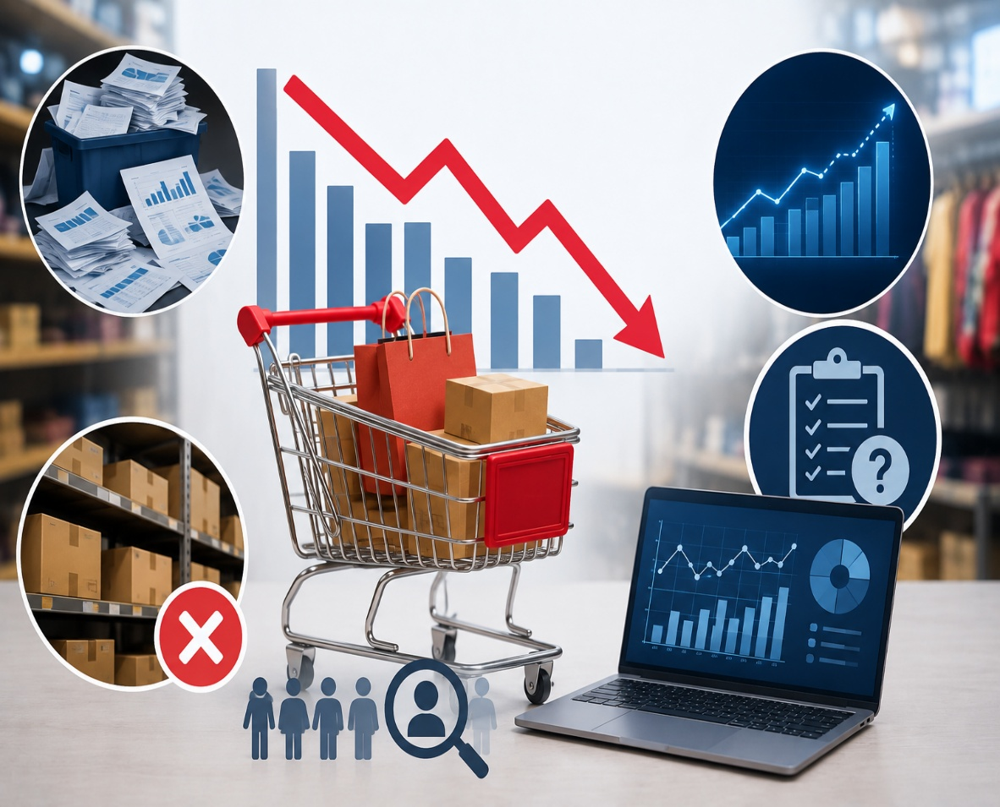
Problem Statement
Retail businesses generate large volumes of sales data, but it is not effectively analyzed to support business decisions.
Inaccurate demand forecasting leads to stock shortages or excess inventory, increasing operational costs and reducing sales.
Traditional forecasting methods fail to accurately capture changing customer preferences, seasonal trends, and market demand.
A Retail Sales Analysis and Demand Forecasting system is needed to predict future demand, improve inventory management, and enhance overall business profitability.

Slide 5
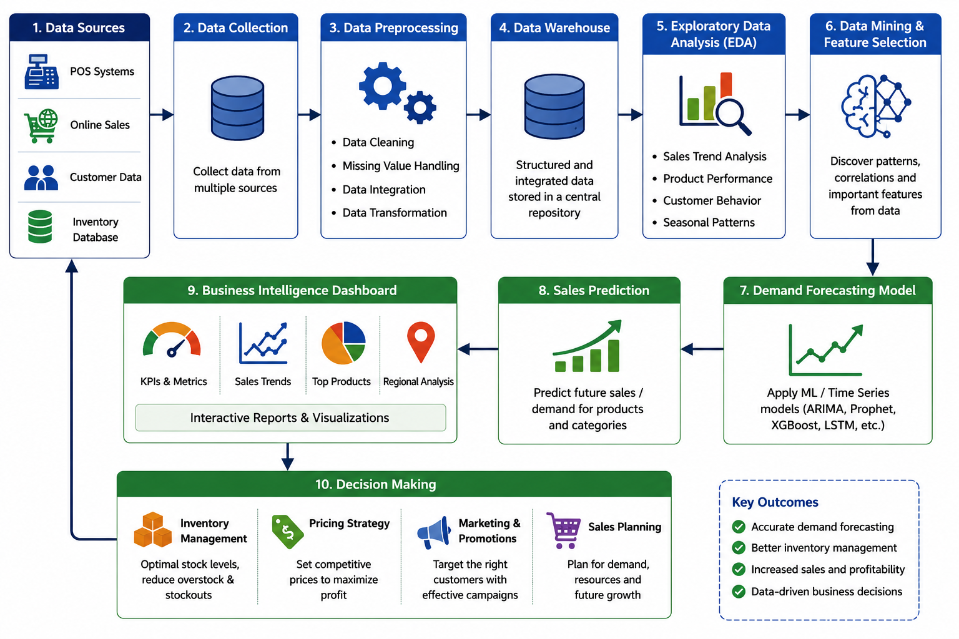
System Architecture

Slide 6
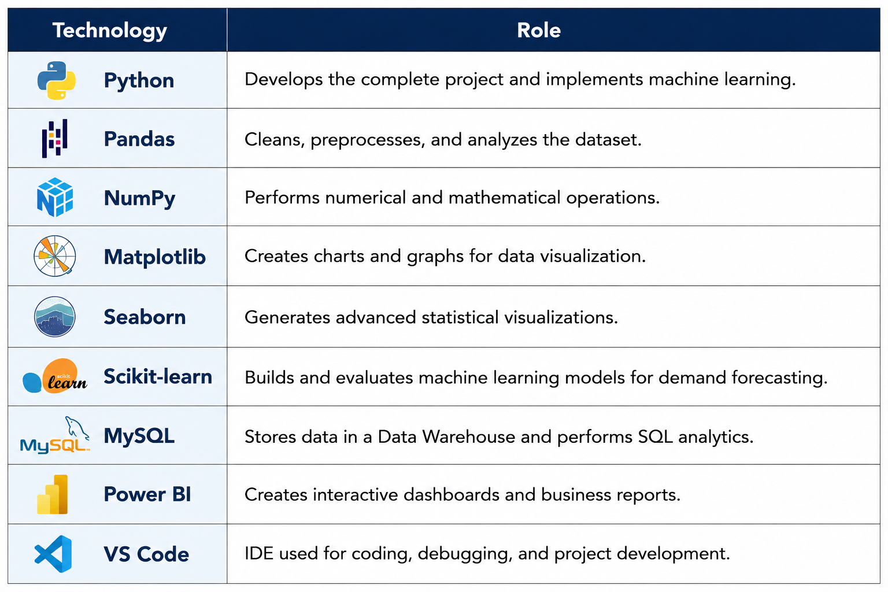
Technologies Used

Slide 7

Literature Review
Year | Title of the Paper | Objectives | Limitations
2022 | Retail Sales Forecasting Using Machine Learning Techniques | Analyze historical retail sales data and apply machine learning techniques to predict future sales and identify important sales patterns. | Forecasting accuracy depends heavily on the quality, completeness.
2022 | Data Mining Techniques for Retail Sales Analysis | Apply data mining techniques to discover hidden patterns, customer purchasing behavior, product relationships, and sales trends from retail datasets. | Large and complex datasets may require significant preprocessing,
2023 | Data Warehouse-Based Business Intelligence for Retail Analytics | Develop a centralized data warehouse to integrate retail sales information and support multidimensional analysis of products, customers, locations, and time periods. | Data integration from multiple sources can be complex, and maintaining an updated data warehouse requires considerable time and resources.
2024 | Machine Learning-Based Demand Forecasting in Retail | Evaluate machine learning models for predicting product demand using historical sales, seasonal trends, product information, and other relevant factors. | Model performance may decrease when market conditions, customer preferences.
2024 | Integrated Retail Analytics Using Data Mining and Business Intelligence | Combine data mining, data warehousing, and business intelligence techniques to analyze retail performance and provide data-driven decision support through dashboards. | The effectiveness of the integrated system depends on data quality, appropriate algorithm selection,

Slide 8
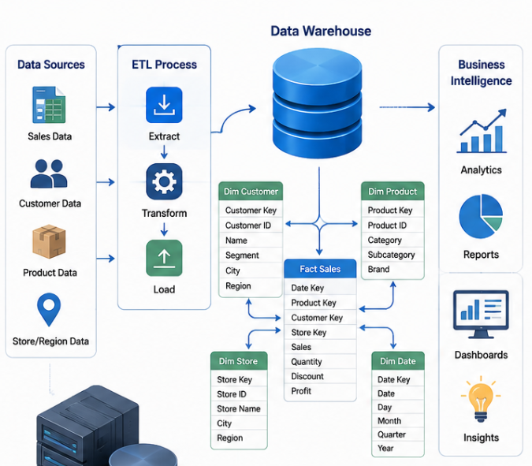
Module 1: Data Warehousing & Business Intelligence
Collect retail sales data from POS systems, online stores, customer transactions, and inventory databases.
Clean, validate, and integrate the collected data into a centralized Data Warehouse to ensure accuracy and consistency.
Organize and analyze the data using Business Intelligence (BI) techniques to identify sales trends, customer behavior, and product performance.
Prepare structured data for the Retail Sales Analysis and Demand Forecasting module to support accurate sales predictions and better business decision-making.

Slide 9
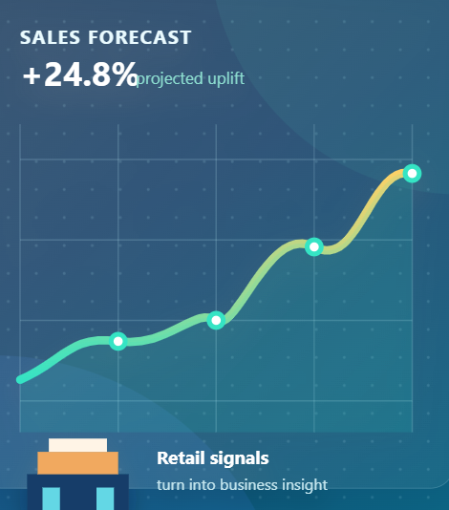
Module 2: Data Mining & Sales Forecasting
Receive cleaned retail sales data from the Data Warehousing & Business Intelligence module for analysis and forecasting.
Apply Data Mining techniques to identify customer purchasing behavior, product demand, and seasonal sales trends.
Use Machine Learning and statistical forecasting algorithms to accurately predict future sales demand.
Generate demand forecasts that help optimize inventory management, improve sales planning, reduce stock shortages, and support better business decision-making.

Slide 10
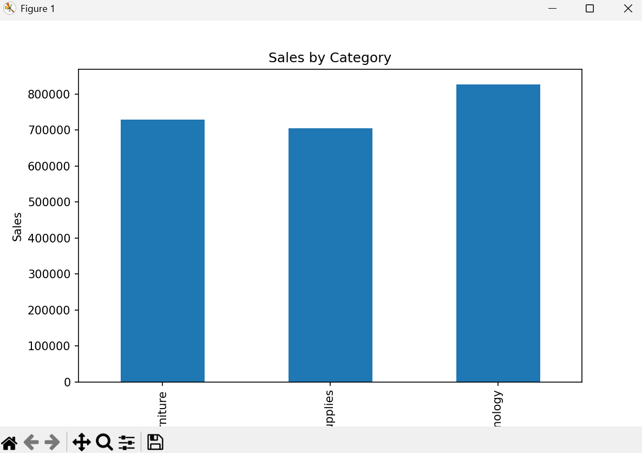
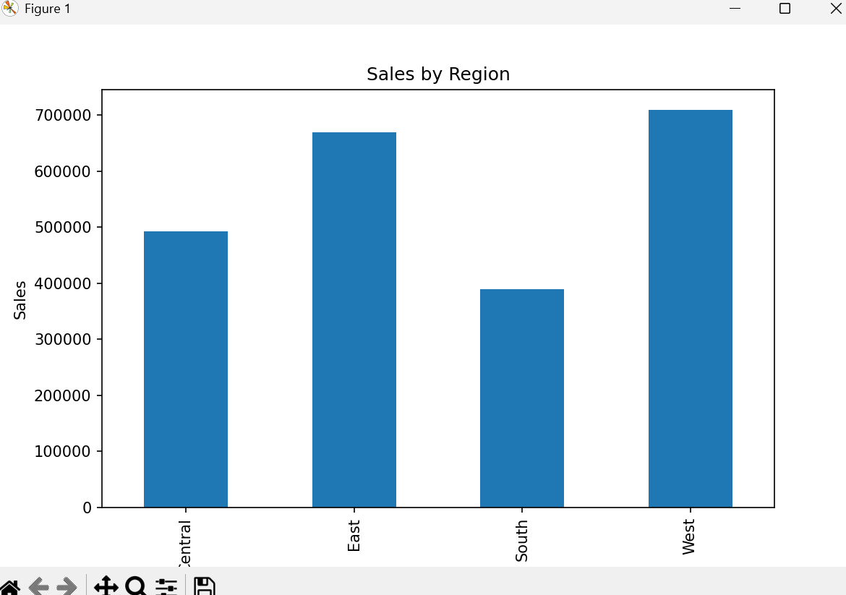
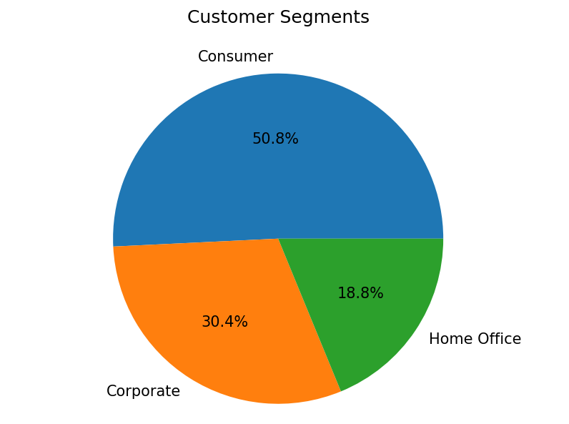
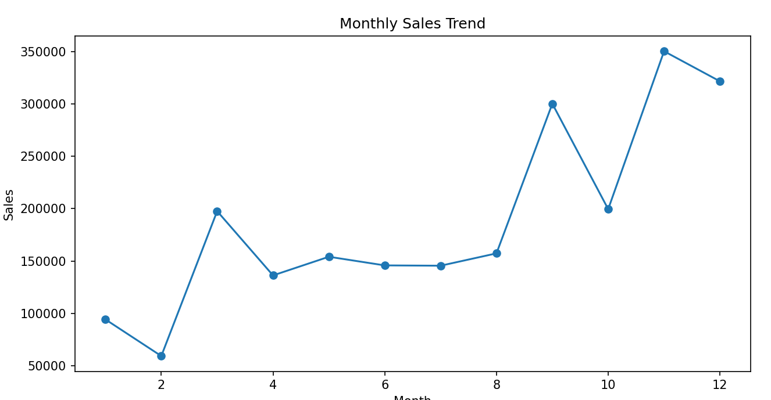
Results & Discussion

Slide 11
Conclusion
The proposed system effectively analyzes historical sales data to identify sales trends, customer behavior, and product performance.
The demand forecasting model accurately predicts future product demand, helping retailers improve inventory management and reduce stock shortages.
The system provides valuable insights that support better pricing, marketing, and sales planning decisions.
Overall, the project improves operational efficiency, enhances customer satisfaction, and increases business profitability through data-driven decision-making.

Slide 12
References
Makridakis, S., Spiliotis, E., & Assimakopoulos, V. (2022). The M5 Accuracy Competition: Results, Findings, and Conclusions. International Journal of Forecasting, 38(4), 1346–1364.
Hyndman, R. J., & Athanasopoulos, G. (2023). Forecasting: Principles and Practice (3rd Edition). OTexts, Melbourne, Australia.
Chollet, F. (2023). Deep Learning with Python (2nd Edition). Manning Publications.
IBM Corporation. (2024). IBM Business Analytics and Demand Forecasting Solutions. Available at: https://www.ibm.com/analytics
Microsoft Corporation. (2024). Microsoft Power BI Documentation – Retail Sales Analytics. Available at: https://learn.microsoft.com/power-bi
Oracle Corporation. (2024). Oracle Retail Demand Forecasting and Inventory Management. Available at: https://www.oracle.com/retail/ \
Pandas Development Team. (2025). Pandas Documentation. Available at: https://pandas.pydata.org/
Scikit-learn Developers. (2025). Scikit-learn: Machine Learning in Python. Available at: https://scikit-learn.org/

Slide 13


